Slide 1
Data Viz DC: Exploring Life Expectancy Relationships
Alex Hernandez

Slide 2
Dataset: Data Spanning 3 Years & 230+ Countries
Dataset: World Development Indicators Dataset
What kind of data was used?
Indicators used:
Birth rate, crude (per 1,000 people)
Life expectancy at birth, total (years)
Agricultural land (% of land area)
Years used:
2011
2012
2013
# of countries used:
Each indicator contained data from 230+ countries for each of the years explored

Slide 3
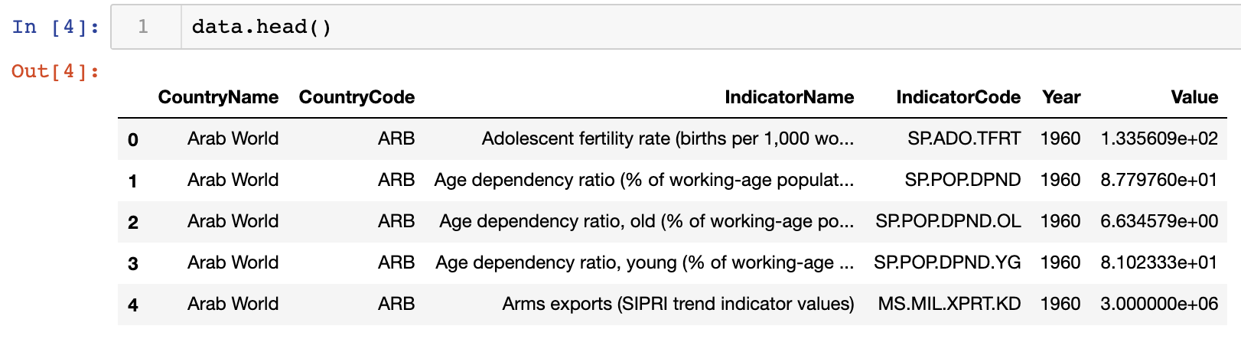

Slide 4
Research Questions #1
Is there a statistically significant relationship between the birth rate of a country and its life expectancy?
Hypothesis: Birth rate and life expectancy will be inversely correlated. That is, countries with higher birth rates will have shorter life expectancies

Slide 5
Research Question #2
Is there a relationship between either the birth rate or life expectancy of a country and the percentage of land area devoted to agriculture?
Hypothesis: The percentage of a country’s land used for agriculture will be positively correlated with birth rate and inversely correlated with life expectancy. That is, countries with higher percentages of agricultural land will have higher birth rates and lower life expectancies.

Slide 6
Birth Rate and Life Expectancy Summary Stats
 | 2011 |  | 2012 |  | 2013
 | Birth Rate | Life Exp. | Birth Rate | Life Exp. | Birth Rate | Life Exp.
Mean | 21.6762 | 70.6395 | 21.5927 | 70.8442 | 21.3269 | 71.0611
Mean Change from Prior Year | N/A | N/A | -0.0835 | 0.2047 | -0.2658 | 0.2168
Std. | 10.515 | 8.5838 | 10.3929 | 8.4410 | 10.348 | 8.2956
Std. Change from Prior Year | N/A | N/A | -0.1221 | -0.1428 | -0.0449 | -0.1454
Mean for birth rate and life expectancy show a slight, but consistent trend of decreasing average birth rates and increasing average life expectancies.
Decreasing standard deviations for both indicators imply a trend toward narrowing the differences between countries

Slide 7
Plots and Correlation for Birth Rate and Life Expectancy
The Pearson Correlation Coefficient for birth rate and life expectancy for each year:
Strong and consistent correlation coefficients for each year indicate that this correlation is significant.
The scatter plots on the following slides visualize this correlation.
Note that relatively few countries populate the extreme end of high birth rate and low life expectancy (shown in the bottom right of the plots).
2011 | - 0.87596
2012 | - 0.87579
2013 | - 0.87595

Slide 8
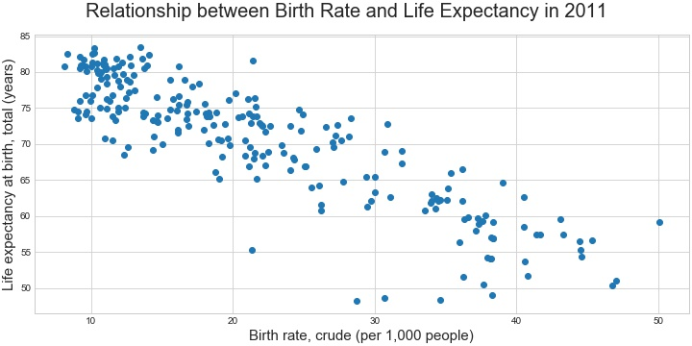

Slide 9
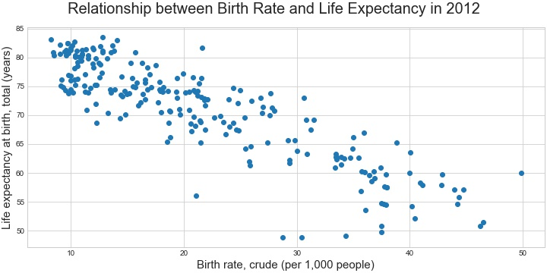

Slide 10
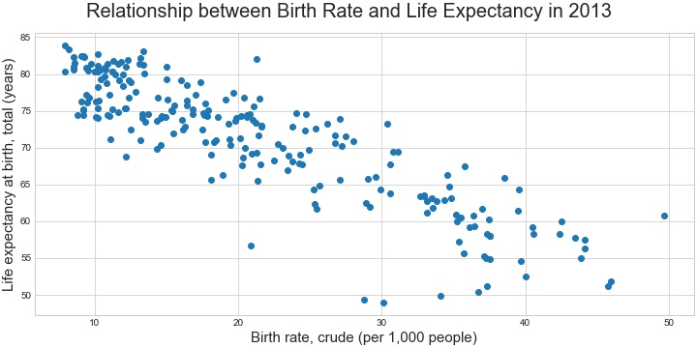

Slide 11
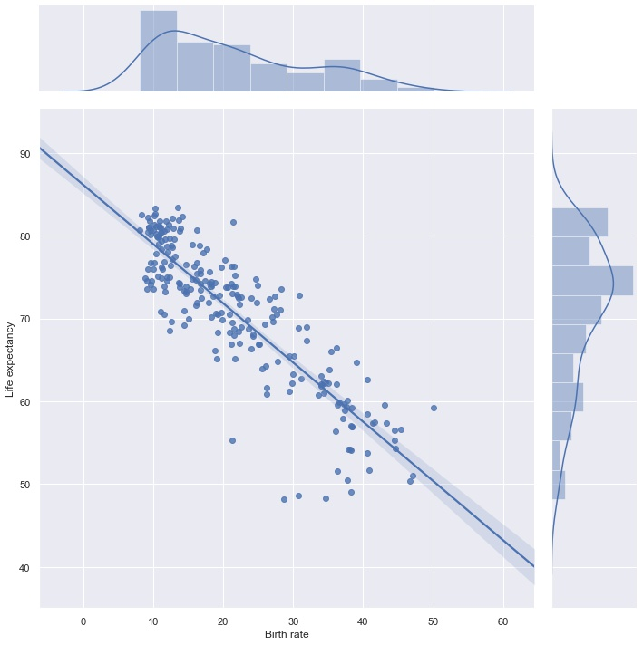

Slide 12


Slide 13


Slide 14
Agricultural Land Percentage Summary Stats
 | 2011 | 2012 | 2013
Mean | 38.367611 | 38.715437 | 38.792605
Mean Change from Prior Year | N/A | 0.347826 | 0.077168
Std. | 20.993092 | 20.874911 | 20.863906
Std. Change from Prior Year | N/A | -0.118181 | -0.011005
Mean percentage of land area that countries devote to agriculture increased each year, with a larger increase in 2012 than in 2013.
Note that these are increases in percentage of total land area of a given country. For example, a 0.348 increase for a large country like the United States represents a significantly larger increase in square mileage devoted to agriculture than for a smaller country like the United Kingdom.
Standard deviation decreased over both years, with a larger decrease in 2012 than in 2013. Decreasing standard deviation indicates that the differences between countries are decreasing overall.

Slide 15
Correlations for Agricultural Land
The Pearson Correlation Coefficient for percentage of a country’s total land area devoted to agriculture and birth rate and life expectancy for each year:
Small correlation coefficient values indicate that correlations are not significant in both cases.
Year | Agricultural Land and Birth Rate | Agricultural Land and Life Expectancy
2011 | 0.188480 | -0.274400
2012 | 0.185185 | -0.276955
2013 | 0.190238 | -0.274435

Slide 16
Plots for Agricultural Land
The following three slides show bubble plots of birth rate, life expectancy, and percentage of agricultural land for 2011, 2012, and 2013.
Reading these plots:
X and Y coordinate locations of each plot correspond to an individual country’s birth rate and life expectancy values on the x- and y-axes
Data point locations are the same as previous three plots
Bubble size corresponds to percentage of land area devoted to agriculture for a given country
Larger bubble indicates higher percentage
Smaller bubble indicates lower percentage
In all plots, note that neither x- nor y-axis begins at 0
Correlation strength is of greater interest than coordinate values. Interpreting correlation strength is not heavily impacted by adjusted axes, but readers should nonetheless remain aware of the axes values.

Slide 17
Plots for Agricultural Land
Interpreting these plots:
Because bubbles of various sizes are fairly evenly distributed, these plots indicate that percentage of agricultural land does not depend heavily on either birth rate or life expectancy, or vice versa.
Lack of significant correlation may not be easily interpreted visually because points are more heavily distributed in the higher life expectancy and lower birthrate (upper left) regions of the plots. This may make bubbles in such regions appear larger when compared with bubbles in less dense regions.
The calculated correlation coefficients are helpful in confirming the lack of significant correlation in this case

Slide 18
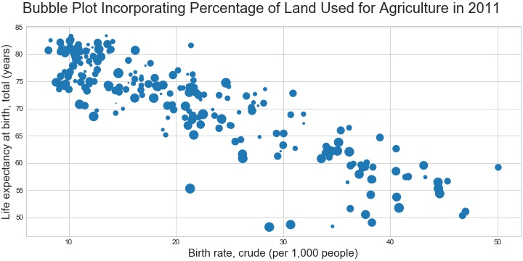

Slide 19
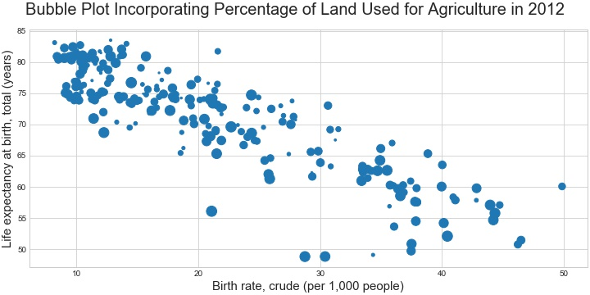

Slide 20
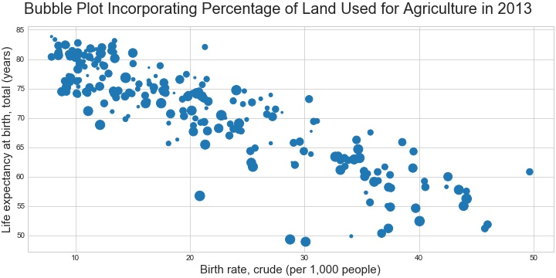

Slide 21
Hypotheses: Supported or Rejected?
Hypothesis #1: Birth rate and life expectancy will be inversely correlated. That is, countries with higher birth rates will have shorter life expectancies.
Analysis supports initial hypothesis
Scatter plot linear trend
High, negative correlation coefficient
Hypothesis #2: The percentage of a country’s land used for agriculture will be positively correlated with birth rate and inversely correlated with life expectancy. That is, countries with higher percentages of agricultural land will have higher birth rates and lower life expectancies.
Analysis rejects initial hypothesis
Relatively even bubble plot size distribution
Low correlation coefficients

Slide 22
Acknowledgements
Analysis and presentation did not receive feedback prior to submission.
Primary sources of information for analysis and presentation were found in UC San Diego course materials.
Various online blogs and forums, most notably Stack Overflow, provided some guidance for solving minor issues with coding.

Slide 23
References
Aside from minor help from coding forums, all of this work was completed by myself. Contributions of coding forums were not sufficient to require citation.

